Slide 1
Customer Support Chatbot with ML
PIP2001 Capstone Project
Review-1
Batch Number: ISE-01
Roll number | Student Name
20211ISE0048 | Pratham U G
20211ISE0044 | Prajwal R Sanu
20211ISE0045 | Nikhil K S
20211ISE0028 | Nithin G
Under the Supervision of,
Mr. Jinesh
Professor
School of Computer Science and Engineering
Presidency University
Name of the Program: Information Science and Engineering
Name of the HoD: Dr. Pallavi R
Name of the Program Project Coordinator: Prof. Srinivas Mishra
Name of the School Project Coordinators: Dr. Sampath A K / Dr. Abdul Khadar A / Mr. Md Ziaur Rahman

Slide 2
Introduction
A customer support chatbot powered by machine learning can automate responses to frequently asked questions, handle routine inquiries, and provide 24/7 assistance. By leveraging natural language processing (NLP)
these chatbots can understand and interpret user inputs more effectively, allowing for a more conversational and human-like interaction.
Chatbots can handle thousands of inquiries simultaneously, reducing wait times and freeing up human agents for more complex issues.
Automating customer support reduces operational costs while maintaining high service standards.

Slide 3
Literature Review
Sl.no | Study | Key findings | Challenges Identified | Proposed Solutions
1 | Shah et al. (2020) | Adoption leads to improved efficiency and customer satisfaction. | Resistance to change among employees and customers. | Training programs for staff and user education on chatbot use.
2 | Kumar et al. (2019) | Effective NLP techniques enhance understanding of user queries. | Limited understanding of context in conversations. | Develop context-aware models using advanced NLP methods.
3 | Gnewuch et al. (2017) | Machine learning enables continuous improvement of responses. | Difficulty in adapting to evolving customer expectations. | Implement feedback loops for real-time learning and updates.

Slide 4
Literature Review
Sl.no | Study | Key findings | Challenges Identified | Proposed Solutions
4 | Adamopoulos et al. (2020) | Personalized interactions lead to higher user engagement. | Generic responses that fail to address individual needs. | Utilize user data to tailor responses and enhance personalization.
5 | Liu et al. (2021) | Many chatbots struggle with multi-turn conversations. | Context loss during extended interactions. | Develop multi-turn dialog management systems.
6 | Morrison et al. (2019) | Security and privacy concerns hinder adoption. | Security and privacy concerns hinder adoption. | Implement robust security protocols and ensure data protection compliance.
7 | Pereira et al. (2022) | Emotional intelligence can improve customer interactions. | Lack of empathetic responses in existing chatbots. | Integrate emotion recognition capabilities into chatbots.

Slide 5
Existing method Drawback
Limited Understanding of Context
Poor Natural Language Understanding
Dependency on Structured Data
Maintenance and Updates

Slide 6
Proposed Method
Bot is Built with NLP for empathetic responses and Socket.IO for fast, bi-directional communication.
Designed with a strong focus on privacy, allowing victims to report incidents without fear of exposure.
HTML5, CSS3, JavaScript, and React.js provide a simple, user-friendly interface for reporting.
MongoDB handles unstructured data (chat logs, reports), offering scalability and support for distributed data with sharding.
Express.js manages requests and API routing, connecting to MongoDB for secure data storage.
Horizontally scalable platform, capable of handling thousands of connections using a cloud-based load balancer.

Slide 7
Objectives
Enhance Customer Experience Provide instant, accurate responses to customer inquiries to improve overall satisfaction and engagement.
Routine Tasks Reduce the workload on human agents by automating responses to frequently asked questions and common issues.
Facilitate 24/7 Availability Offer continuous support to customers, regardless of time zones, ensuring that help is always accessible.
Improve Scalability Enable the support system to handle a growing volume of inquiries without a proportional increase in staffing.
Reduce Operational Costs Lower customer support costs by decreasing the need for large support teams while maintaining high service quality.

Slide 8
Methodology
HTML5 and CSS3 are used for the home, login, and register pages, with JavaScript handling interactivity, form validation, and animations.
React.js is used to build the user interface for the chatbot and Q&A community, ensuring smooth and responsive interactions.
Tailwind CSS integrated with React.js for a visually appealing, responsive design.
Node.js and Express.js handle API calls, user authentication, and chat processing.
Uses Gemini API to provide chatbot responses and assist with evidence collection and reporting.
MongoDB stores user data, chat logs, community discussions, evidence, and crime statistics.

Slide 9
Software components
Frontend: HTML5,CSS3, JavaScript, React.js, CSS
Backend: Node.js and Express.js, Socket.IO
NLP Integration: Gemini API
Database: MongoDB

Slide 10
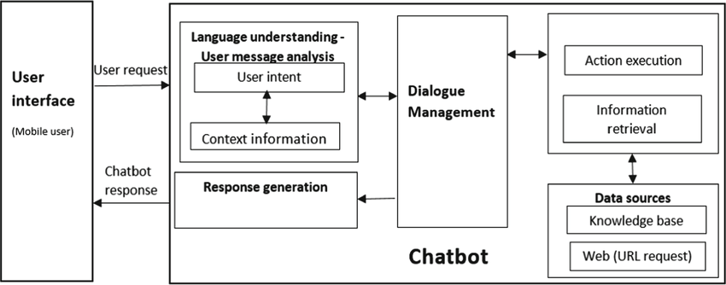
Architecture

Slide 11
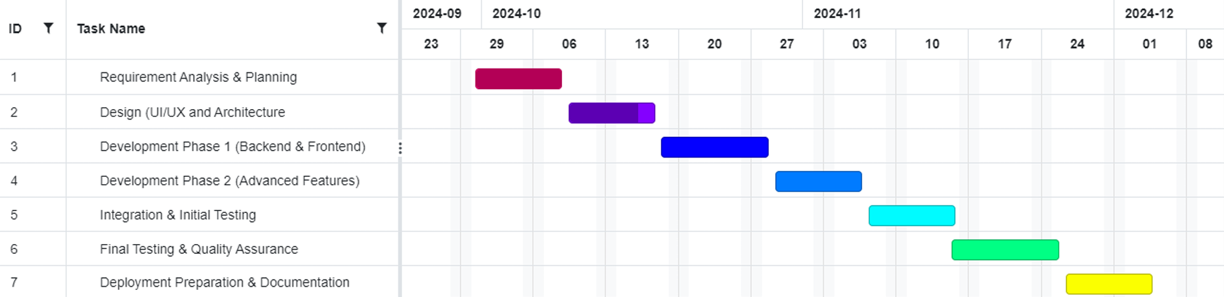
Timeline of Project

Slide 12
Expected Outcomes
Improved Response Times
Higher Customer Satisfaction
Increased Efficiency
Consistent Service Quality
24/7 Availability
Cost Savings

Slide 13
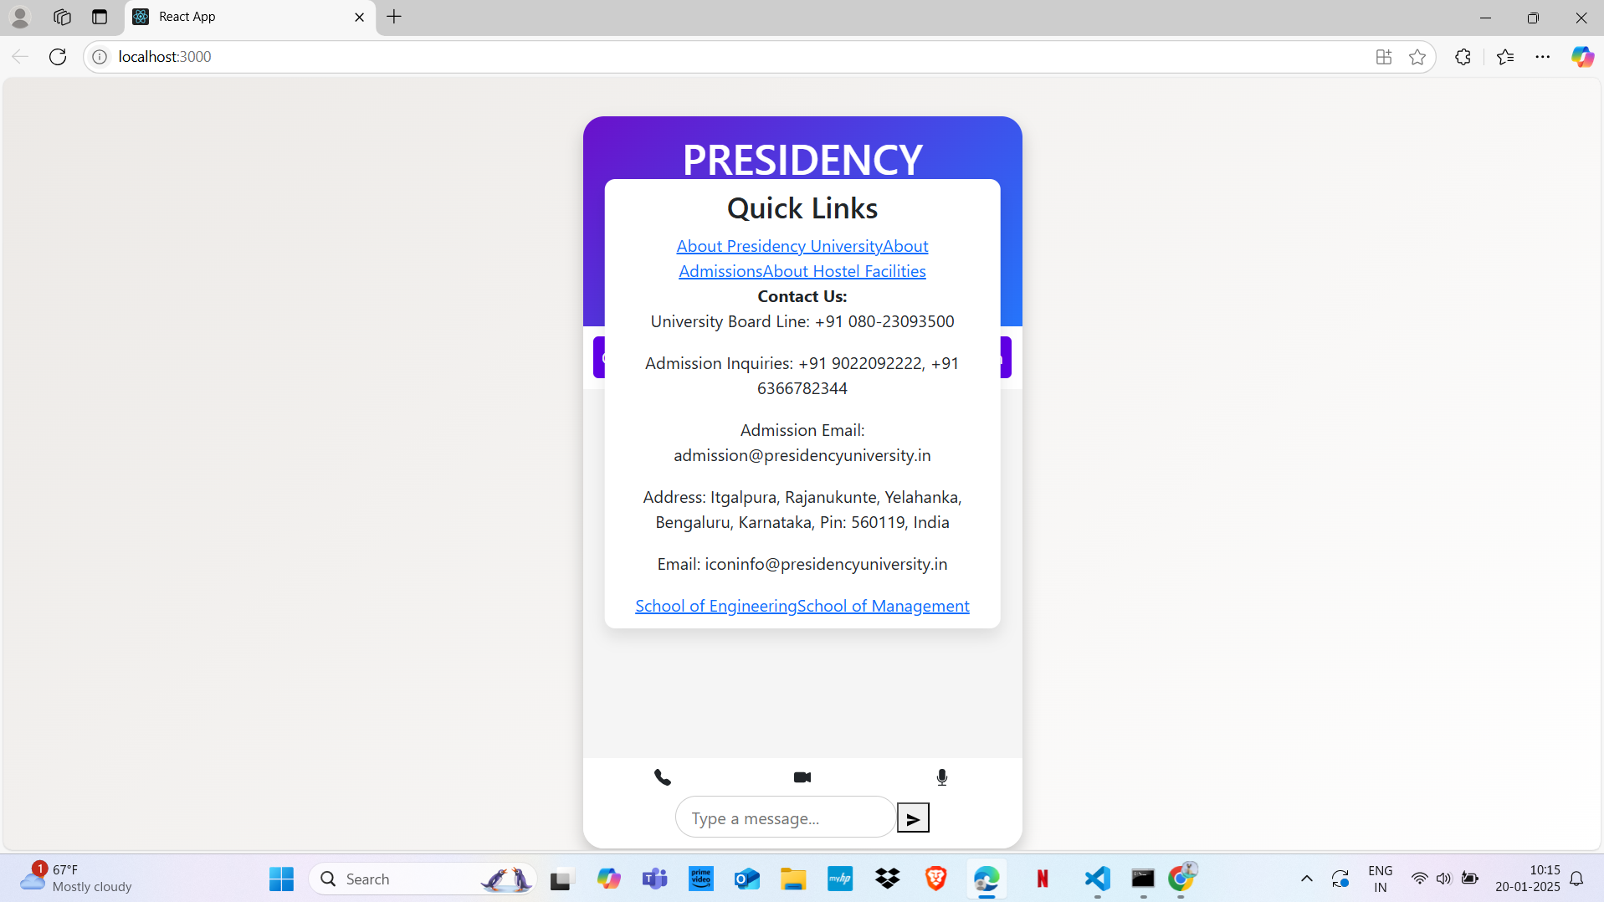
Output of Project

Slide 14
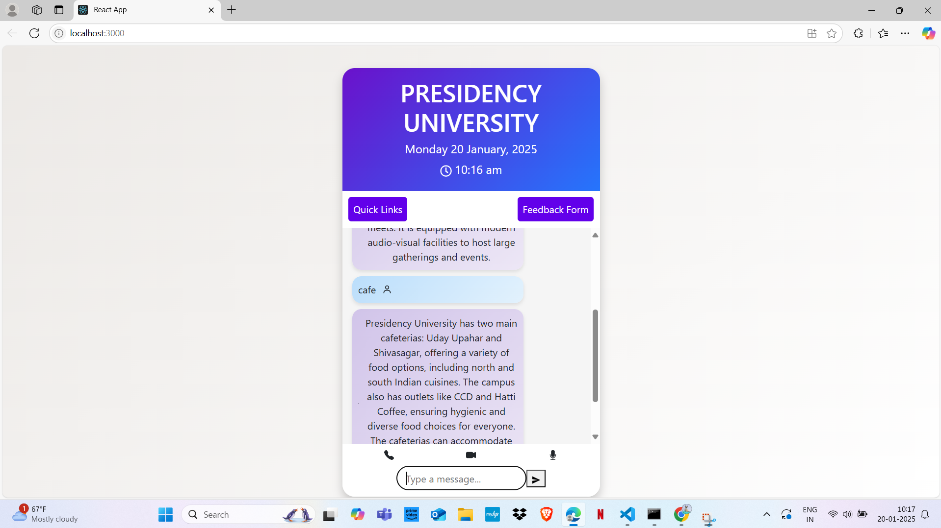

Slide 15
Conclusion
Implementing a customer support chatbot powered by machine learning represents a significant advancement in enhancing customer service capabilities. By automating routine inquiries and providing instant, personalized responses, businesses can improve efficiency, reduce operational costs, and deliver a superior customer experience.
The architecture of such a chatbot, with its integration of natural language processing, dialog management, and machine learning, allows for nuanced interactions that adapt to user needs. As these chatbots learn from ongoing interactions and feedback, they become increasingly effective in addressing a broader range of queries

Slide 16
Github Link
The Github link provided should have public access permission.
Github Link: https://github.com/PrathamUdayG/PresidencyChatBot.git

Slide 17
References
Adamopoulos , P., et al. (2020). "The Role of Chatbots in Enhancing User Experience."
Gnewuch , U., et al. (2017). "Towards Human-Level Conversational Agents: A Survey."
Kumar, A., et al. (2019). "Natural Language Processing Techniques for Chatbots."
Liu, B., et al. (2021). "Challenges in Developing Effective Chatbots for Customer Support."
Morrison, D., et al. (2019). "Security and Privacy Considerations for Chatbot Implementations."
Pereira, S., et al. (2022). "Future Directions for Emotional Intelligence in Chatbots."
Shah, A., et al. (2020). "Adoption of Chatbots in Customer Service: A Case Study."

Slide 18
Thank You

